Slide 1
MobiGuider Architecture
High level overview

Slide 2
Agenda
Architecture Overview
Practices
Q&A

Slide 3
Architecture Overview
Services
General
Hosted in IIS7
Windows Communication Foundation
SOAP/XML or Binary Serialization
Classification
Repository Services
Adapter Services
Application Services
Choreography Services
Infrastructure Services
User Interfaces
ClickOnce Deployed Windows Client Applications
Published on IIS Site
Windows Presentation Foundation
On-Demand Consumption

Slide 4
Conceptual Service Layers

Slide 5
Repository Services
Data Access Abstraction Layer
Access through:
If consumer on same machine as repository: Net.Pipe “netNamedPipeBinding”
or Http(s) “wsHttpBinding”
Service Naming: Pms.<DataStoreName>.Repository
1 Repository per DataStore
Cr-U-D + Selection operations
MS Data Transaction Controller (if DB resides on different machine)
Consumed by Application Services
Examples:
Pms.Transmodel.Repository
Pms.Eod.Repository
Pms.PGS.Repository
….

Slide 6
Application/Infrastructure Services
Business Logic Abstraction Layer
Access through Http(s)
Naming: Pms.<ApplicationName>.Service
1 Service per Applet
Consume: Repository Services or other Application Services
Examples:
Pms.Interchanges.Service
Pms.Obstructions.Service
Pms.PoITracker.Service
Pms.MessageCenter.Service
….

Slide 7
Adapter Services
“Old Services” Abstraction Layer
Access through Http(s) “wsHttpBinding”
Naming: Pms.<OldServiceName>.Adapter
Allow for a gradual phase-out of existing Windows Service Based Service Components
Examples:
Pms.LocationService.Adapter
Pms.TimeTableService.Adapter
…

Slide 8
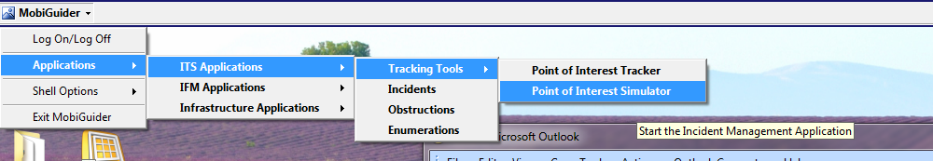
User Interfaces (Applets)
Windows Applications (WPF)
Zero-Configuration
On Demand Consumption via “Shell” application

Slide 9
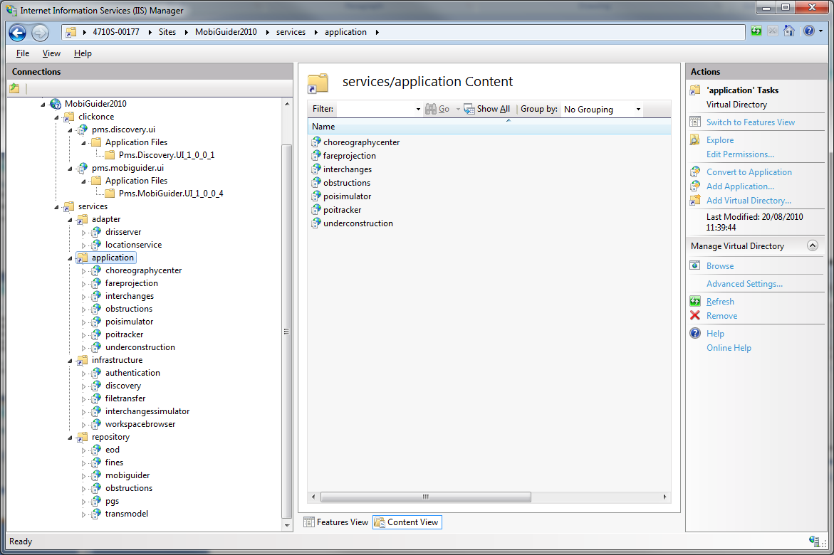
Practice: Default Deployment

Slide 10
Practice: Release to QA
Dedicated Development/Testing Environment
1 release of FULL codebase at the end of each sprint
1 release document containing chapters for each component.
Service Dependency Diagrams see central Enterprise Architect Repository on \\PSBETICDB1\EnterpriseArchitect

Slide 11
Practice: Database Policy
Database releases using standard tools (VS2010 Database Projects)
Custom development for customers => dedicated Database
Pms.Arriva.Db
Pms.Veolia.Db
…
Transmodel Database is OUR OWNERSHIP, not the customer’s => Patches are obligatory.

Slide 12
Questions and Answers

